Slide 2
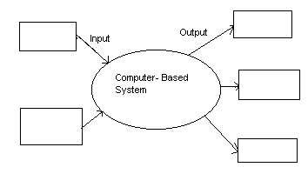
Dataflow Diagram
Rectangle = information producer or consumer
Oval = software element that transforms info
Arrow = data item
information repository (not shown)

Slide 3
Functional Modeling DFD - 1
Shows the relationships among
external entities
process or transforms
data items
data stores
DFD's cannot show procedural detail like conditionals or loops
DFD’s only show the flow of data through the software system

Slide 4
Functional Modeling DFD - 2
Refinement from one DFD level to the next should follow approximately a 1:5 ratio
This ratio will reduce as the refinement proceeds
To model real-time systems, structured analysis notation must be available for time continuous data and event processing

Slide 5
Creating DFD - 1
Level 0 data flow diagram should depict the system as a single bubble
Primary input and output should be carefully noted
Refinement should begin by consolidating (for representation at the next level):
candidate processes
data objects
data stores to be represented at the next level
Label all arrows with meaningful names

Slide 6
Creating DFD - 2
Information flow must be maintained from one level to level
Refine one bubble at a time
Write PSPEC for each bubble in the final DFD
"mini-spec" written using English or another natural language or a program design language

Slide 7
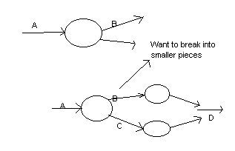
DFD Refinement

Slide 8
DFD/CFD Level 0 - Part Number Analysis (PNA) System
WKConnectors.XLS
Spreadsheet Information
CSV File Creation
(WKConnectors.CSV)
Display Monitor
WKConnectors Delimited Text
Information
Report Results
Table1.CSV
PART NUMBER ANALYSIS (PNA) Tool
Table1 Delimited Text Information
File
Table2 Delimited Text Information
Report Results
Table2.CSV
Report Results
Printer
- Command
- PN data
User

Slide 9
DFD/CFD Level 1 - Part Number Analysis (PNA) Tool
WKConnectors Delimited Text
information
Report Results
Validation Results
Table1 Delimited Text
information
Validate Data
Process Report
Report Results
Print / Save
Data
Report Results
Table2 Delimited Text
information
- Command
- PN data

Slide 10
DFD/CFD Level 2 - Validate Data
WKConnectors Delimited Text
information
Make
tbl_createdWKConn
tbl_Classification
Relevant WKConnector
Records
Category
Reference ID
Validation Results
- Command
- PN data
Make WKConn
tbl_createdWKConn
WKConn field data
Component Remarks
Category ID
tbl_createdT1
Analyze/Classify Data
T1 Field data
Relevant T1 Record(s)
Criteria:
- dbs
- strCriteria
- strOrigPN
Print / Save
Data
Make tbl_createdT1
Criteria:
- dbs
- strOrigPN
Table1 Delimited Text
information
T2 Field data
Make tbl_createdT2
tbl_createdT2
Table2 Delimited Text
information
Relevant T2 Record(s)

Slide 11
DFD/CFD Level 3 - Make tbl_createdT1
Criteria:
- dbs
- strCriteria
- strOrigPN
Table1 Delimited Text
information
qry_Table1UniquePN
Recreate tbl_createdT1
Table1 Query Results
Relevant T1 Record(s)
DFD/CFD Level 3 - Make tbl_createdT2
Criteria:
- dbs
- strOrigPN
qry_Table2PrelimUnique
Recreate tbl_createdT2
Table2 Delimited Text
information
Table2 Query Results
Relevant
T2Record(s)

Slide 12
Creating Control Flow Diagrams
Begin by stripping all the data flow arrows form the DFD
Events (solid arrows) and control items (dashed arrows) are added to the diagram
Create CSPEC for each bubble in final CFD
contains an STD (state transition diagram) that serves as a sequential specification of the bubble’s behavior

Slide 13
Process Description Tools
Modular Design
Based on combinations of three logical structures, sometimes called control structures which serve as building blocks for the process
Sequence
Selection
Iteration - looping

Slide 14
Process Description Tools
Structured English
Must conform to the following rules
Use only the three building blocks of sequence, selection, and iteration
Use indentation for readability
Use a limited vocabulary, including standard terms used in the data dictionary and specific words that describe the processing rules

Slide 15
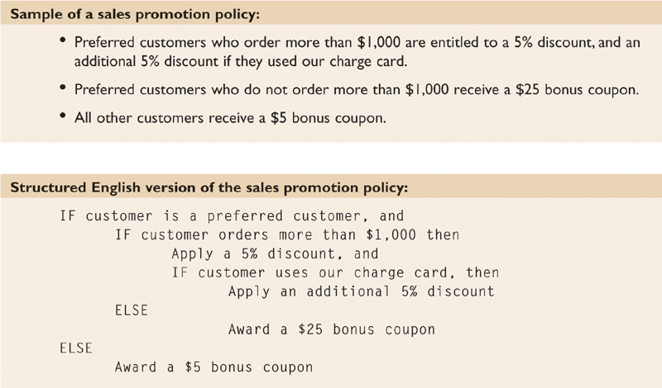
Process Description Tools
Structured English
Might look familiar to programming students because it resembles pseudocode

Slide 16
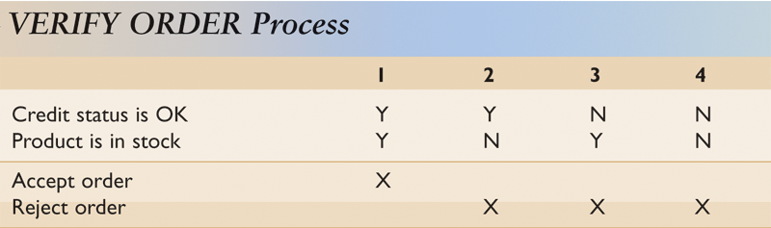
Process Description Tools
Decision Tables
Shows a logical structure, with all possible combinations of conditions and resulting actions
It is important to consider every possible outcome to ensure that you have overlooked nothing

Slide 17
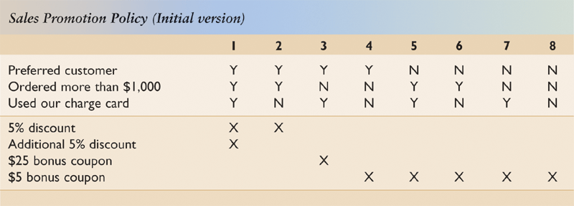
Process Description Tools
Decision Tables
Can have more than two possible outcomes
Often are the best way to describe a complex set of conditions

Slide 18
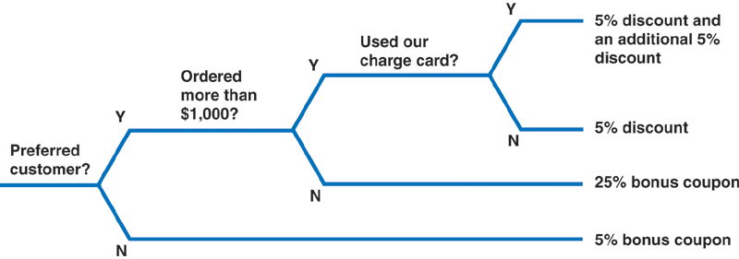
Process Description Tools
Decision Trees
Graphical representation of the conditions, actions, and rules found in a decision table
Whether to use a decision table or tree often is a matter of personal preference

